Slide 1
Kennett Fire & EMS Regional Commission
2027 Budget Update
Originally presented on September 8, 2026.
Updated based on discussions at that Meeting.
Notes:
Last updated 9/8/2026, 9:30pm

Slide 2
Fire & EMS Coverage
Required by the Second Class Township Code & Borough Code to provide fire and EMS under the municipal laws of Pennsylvania.
P.L.350, No. 60, The Second Class Township Code, Section 1553,
Emergency Services, states,
“The township shall be responsible for
ensuring that fire and emergency medical services
are provided within the township…”

Slide 3
Brief History of KFERC
Study conducted by VFIS Education, Training and Consulting in 2016 to evaluate the feasibility of developing a system approach to EMS and fire and rescue services.
In 2017 KFERC was established through an Inter-Municipal Cooperation Agreement due to a desire to “provide for inter-municipal collaboration and the pooling of municipal resources and funds for the provision of fire, rescue, and emergency services within an area…”
Cooperation Agreement names Longwood, Kennett and Po-Mar-Lin Fire Companies as the Service Providers who remain separate, independent legal entities.
“The Commission shall have no authority to control the day-to-day operations of each independent Service Provider, and the Service Providers shall not be deemed agents of the Commission or the Municipalities.”
In 2026 the Inter-Municipal Cooperation Agreement was amended to add Kennett Square Borough as a voting member of the Commission. They join the Townships of East Marlborough, Kennett, Pennsbury, Pocopson, and Newlin.
Notes:
KFERC was established as the funding mechanism.
The Service Providers (fire companies) remain separate independent legal entities with control of day-to-day operations

Slide 4
KFERC 2027 Budget Process
August 18, 2026 KFERC Meeting: Regional Fire Department presented their draft 2027 budget and funding request
KFERC Administrator provided calculations of impact to municipalities based on update funding allocation percentages and options related to capital funding plan
KFERC Commissioners discuss impact with their governments
September 8, 2026 KFERC Meeting: Commission comes to consensus on what the proposed funding is for 2027 Budget
September 29, 2026 Special KFERC Meeting: Commission votes on the 2027 KFERC Budget

Slide 5
Funding Fire & EMS
6 municipalities pay a portion of KFERC budget based on Allocation Formula
KFERC uses the money to:
  Fund a portion of the Regional Fire Department operating expenses
  Pay the Volunteer Firefighters Incentive
  Pay for some vehicles and capital equipment
  Reimburse municipalities for worker’s comp payments they make for volunteer firefighters
  Cover overhead such as Audit, D&O Insurance, and Administrator
    Approximately $24,500 or 0.46% of operating is spent on KFERC.
    99% of KFERC budget goes directly to Fire & EMS services

Slide 6
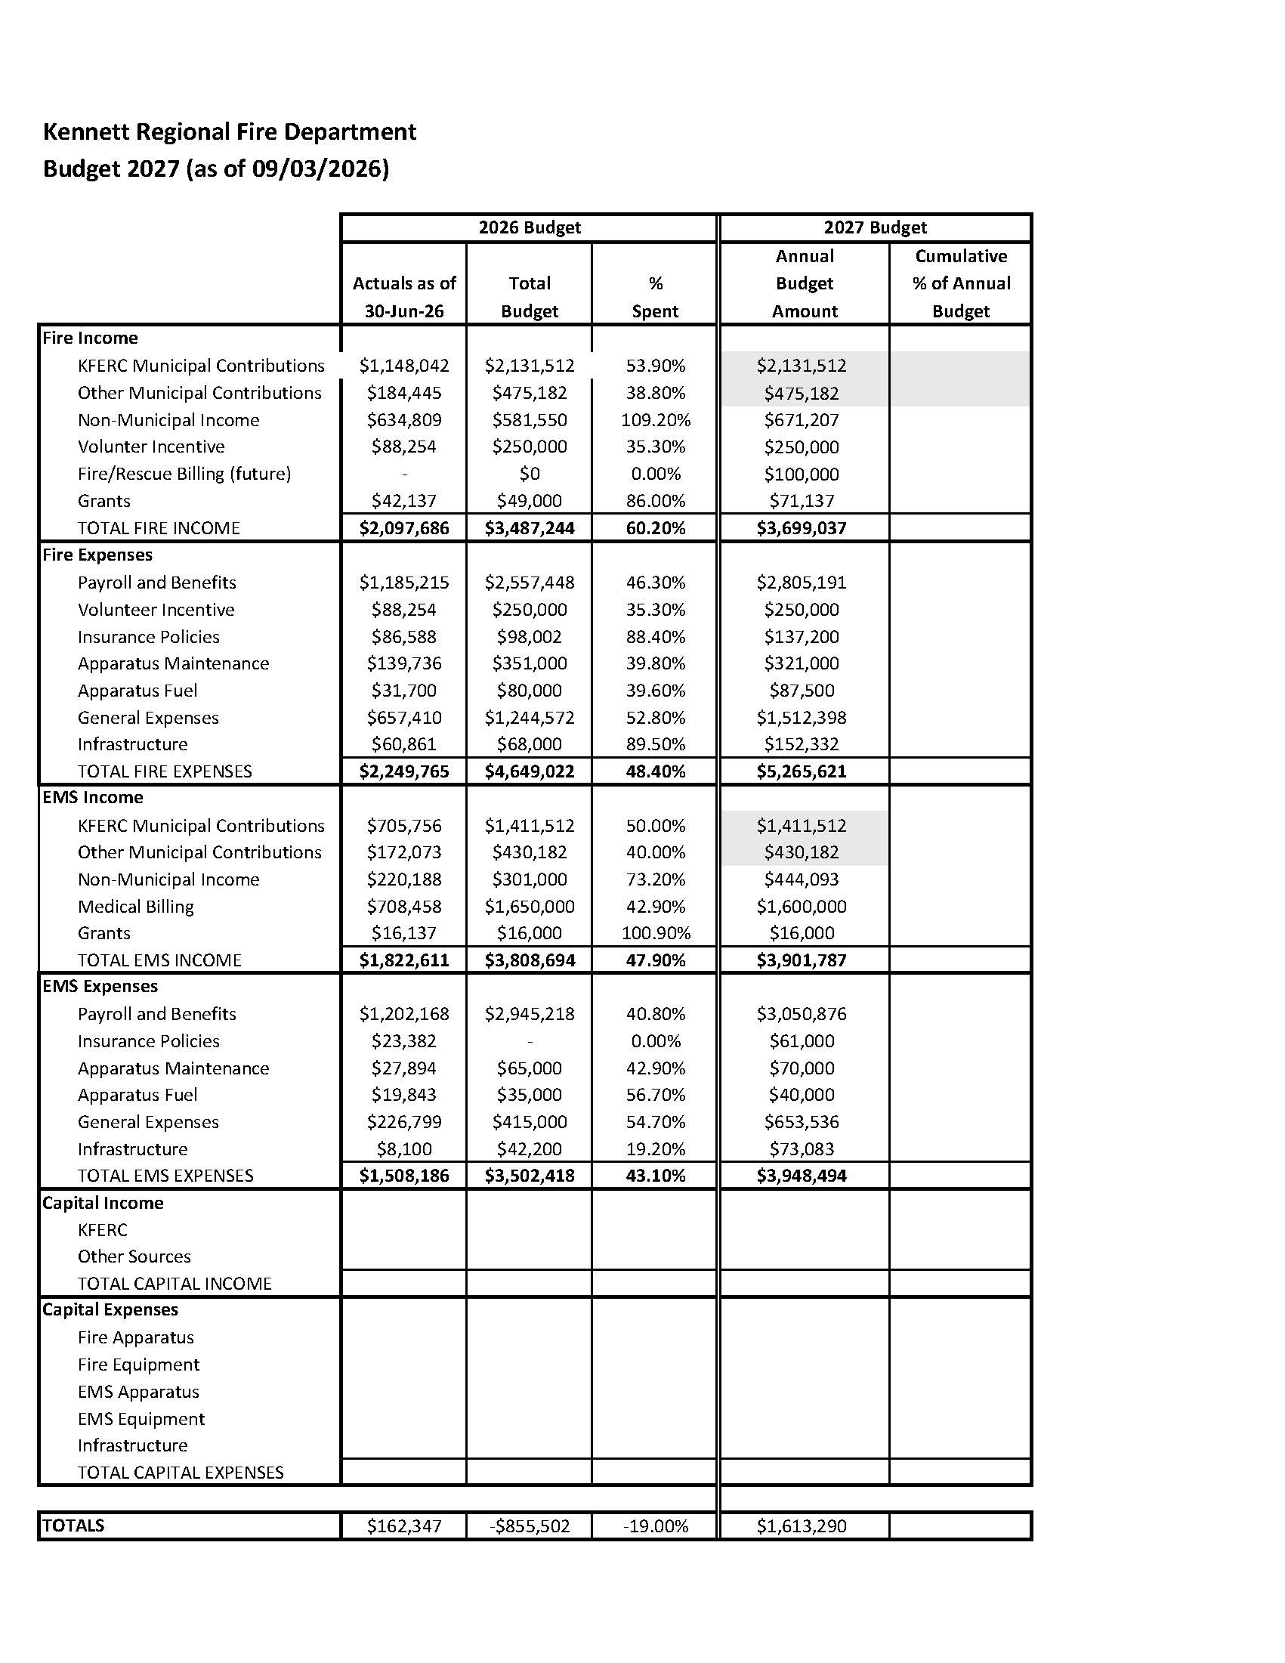
Regional Fire Department Draft 2027 Budget

Slide 7
Regional Fire Department Draft 2027 Budget

Slide 8
Regional Fire Department
2027 Budget Requests – Operating
$323,000 | Pay scale increase; every 3 years
$90,000 | Expand power truck hours to cover peak call volume. Increase to 12 hour day from 10 hours; schedule Monday-Friday
$181,000 | Additional Fire Staffing Coverage - ensure two tiller drivers around the clock to help spread out volunteers a little more.
$110,000 | Establish fire inspection program; would eventually be revenue generating for Fire Department
$65,000 | Tactical EMS ops - equipment needed in service as paramedics for SWAT
$769,000 | TOTAL
-$123,000 | Covered by Regional Fire Department
$646,000 | Request to KFERC

Slide 9
KRFD Workforce – Career Staff Overview
Full Time EMS - 16
Fire Admin - 3
Admin - 4
PT/PRN EMS - 30
FT Fire - 10
PRN Fire – 32
Total of 33 FT employees currently
*figures as of 09/06/26 and subject to change
PRN means “pro re nata” or “as needed”
Notes:
PRN

Slide 10

Fire and EMS Staffing
Fire Staffing:
  3 firefighters/rig (minimum)
  Full Time operate on 2-2-3 schedule 0600-1800, 7 days a week
  PRN staffing supplement day shifts, driver shift during week, and night shifts on weekends
EMS Staffing:
  2 EMS providers per unit
  MICU 25 and MICU125
  24/72 shifts
  4 platoons of 4 FT providers for 24/7/365 coverage
  PRN staff fill in for standbys, time off, power truck, call backs, etc.

Slide 11
Administrative Staff
Office management and clerical duties
Community Relations/Community Risk Reduction
  County and state lobbying efforts
  Local public awareness efforts
AP/AR
Payroll/Benefits
Oversight of billing
QA/QI
Training
  Scheduling
  Content management
  Certification tracking
  Workforce Development and Proficiency
Two out of four admins are cross trained in Fire/EMS. The top priority of all cross-trained staff is emergency responses.

Slide 12
Payroll and Benefits Factors
Pay Scale
Rate determined by experience, years of service, and certification level
Additional rates ($0.50 - $1.00) for various leadership (Officer, Instructor) and public outreach certifications (CPR instructors, car seat technicians, etc.).
Benefits Package
Full-time employees receive medical and dental coverage.
Full-time employees = 403b Retirement Fund with 5 percent CO match.
STD/LTD/Accidental Death and Dismemberment

Slide 13
Payroll Expenses – 2026 (01/01/2026 through 06/30/2026)
 | Fire | EMS | Admin | Total
Salaries | $666,920.04 | $737,662.50 | $229,144.21 | $1,633,726.75
Payroll Taxes |  |  |  | $142,790.55
Health Care/Dental Costs | $121,942.59 | $186,117.45 | $77,198.56 | $385,258.60
Retirement | $12,111.78 | $21,456.10 | $10,517.04 | $44,084.92
STD/LTD/ACCD | $4,739.80 | $5,417.13 | $2,699.64 | $12,856.57
Total | $805,714.21 | $950,653.18 | $319,559.45 | $2,218,717.39

Slide 15
Financial View of Pay Scale Request – 2026 to 2027
Payroll and Benefits for Regional Fire Department
 | 2026 Budget | 2027 Budget | % Change
Fire Payroll & Benefits | $2,557,448 | $2,805,191 | 9.69%
EMS Payroll & Benefits | $2,945,218 | $3,050,876 | 3.59%
TOTAL | $5,502,666 | $5,856,067 | 6.42%
Salary Review: every three years adjustment to base salary; last one was 2024

Slide 16
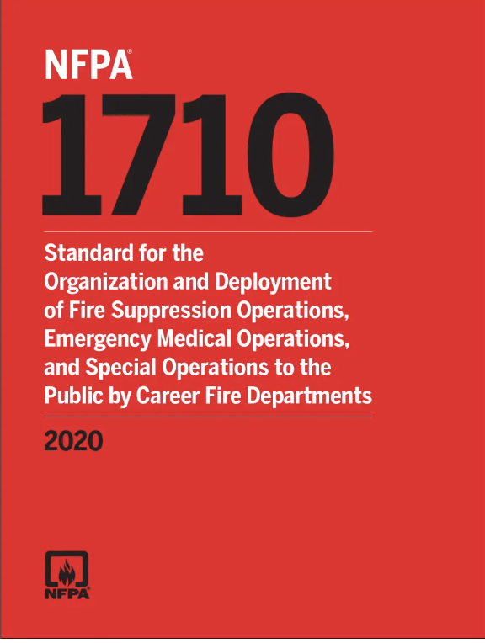
Benefits to Increased Staffing
National Institute of Standards & Technology (NIST) live-burn experiments show that four-person crews complete critical fireground tasks 30% faster than two-person crews and 25% faster than three-person crews.
Four-person crews are more effective in fire suppression and rescue efforts, leading to safer outcomes across all types of emergencies.
When departments are fully staffed, it reduces fire fighter burnout, fatigue, and injuries – ensuring fire fighters are ready to properly respond when there’s an emergency.
NFPA 1710 is the industry standard when it comes to safe and effective fire department staffing standards. While not legally required, it serves as the benchmark for professional fire departments across North America.
NFPA is the National Fire Protection Association is a worldwide nonprofit focused on minimizing the negative effects of fire & electrical hazards. Their standards are well recognized as industry best practices for fire and electrical safety.

Slide 17
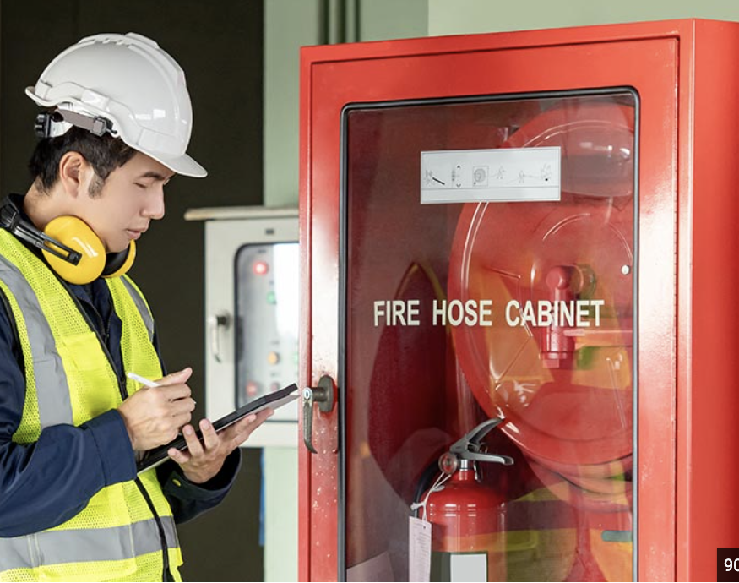
Fire Inspector Program
Identify potential risks to local properties and non-compliance with codes that can lead to casualties and property loss.
They also play an important part in keeping firefighters and EMS workers safe at incident scenes.
Documented CRR programs support fire department accreditation and can help improve your ISO score, which feeds directly into property insurance premiums across your jurisdiction.

Slide 18
Challenges of Fighting Fires in 2026
With the introduction of composite and man-made materials in the building and construction process, fires are burning quicker and hotter and are off gassing toxic chemicals. The result is the need for more protective equipment, more rapid response, and more fully trained staff for a wide range of complicated fire/smoke environments
Fires double in size every 3 minutes
  Goal is 3-5 gallons of water per second to fight the fire.
Our region is home a wide variety of geographic and topographical challenges including dense woodlands, waterways, floodplains, urban environments, suburban enclaves and agriculture. As a result, a wide variety of fire and rescue equipment is needed to safely address these individual challenges.
Call volume has greatly increased – Particularly calls that are occurring at the same time
Notes:
When you talk about cost you also have to look at why the costs are going up.
I live in a 100 year old stone house. We can’t get good wifi everywhere but it’s not going to burn to the ground either.

Slide 19
Decrease in Volunteer Fire Fighters
For decades there has been discussion of the looming public safety crisis as membership in the volunteer fire service decreases
In 2018, the PA Senate reported* a severe decline in volunteers over the previous 40 years
300,000 to 38,000 = overall loss of 262,000 volunteers as of 2018
Volunteer decline is due to changing work and school environment where community members are no longer available on a rapid fire emergency basis.
Fewer than 500 volunteer fire fighters eligible for Chester County Volunteer FF Tax Credit
Todays’ equipment in both fire & EMS is both highly complex and demanding, requiring advanced training.
Fire Fighters require an initial 186 hours of training just for Fire Fighter I – two nights per week plus every weekend for 3 months. Plus additional certifications and time each month for ongoing training requirements.
Notes:
The Regional Fire Department is a combination department with paid staff and volunteers working together to provide 24/7 protection. The decline in volunteers absolutely contributes to the cost increases over the last 10 years.

Slide 20
Operating Increase Over Time
Proposed increase is $646,000 for 2027
Notes:
If you look back you can see the 3 year salary adjustment also impacted the 2024 operating budget increase.

Slide 21
Funding Fire & EMS Fleet (Vehicles)
Because of the wide variety of fire and rescue situations, our fire fighters need a range of equipment.
Cost of fire vehicles in particular has seen double digit price increases annually since 2021.
Lead time for receipt of vehicles has increased to 36-54 months after the initial order is place. For example, a ladder truck ordered in Feb. 2024 is not expected to be delivered until 2029.
Fire vehicles (apparatus) are less than 1% of trucks on the road; few manufacturers of these custom built vehicles.
Todays’ fire and rescue vehicles, by National Fire Protection Association (NFPA) standards, are highly technical computers on wheels requiring advanced training and skills to operate.
Equipment must be replaced on a regular scheduled basis in order to comply with NFPA standards.
Notes:
Can’t talk about costs without looking at the need to fund vehicles and equipment.

Slide 22
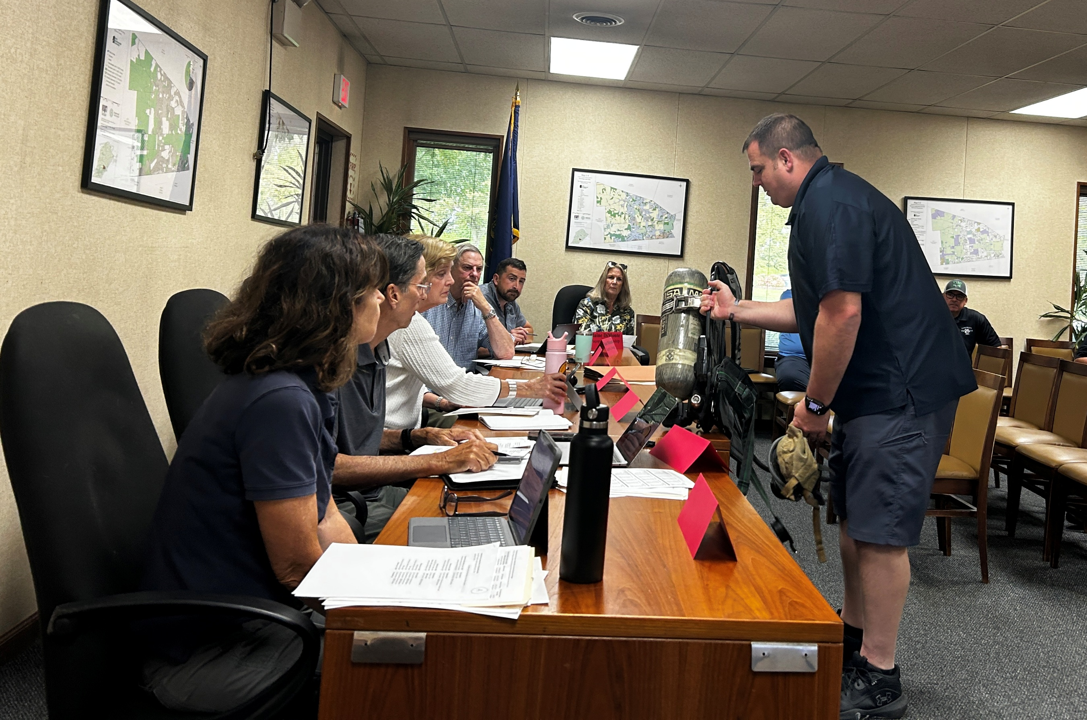
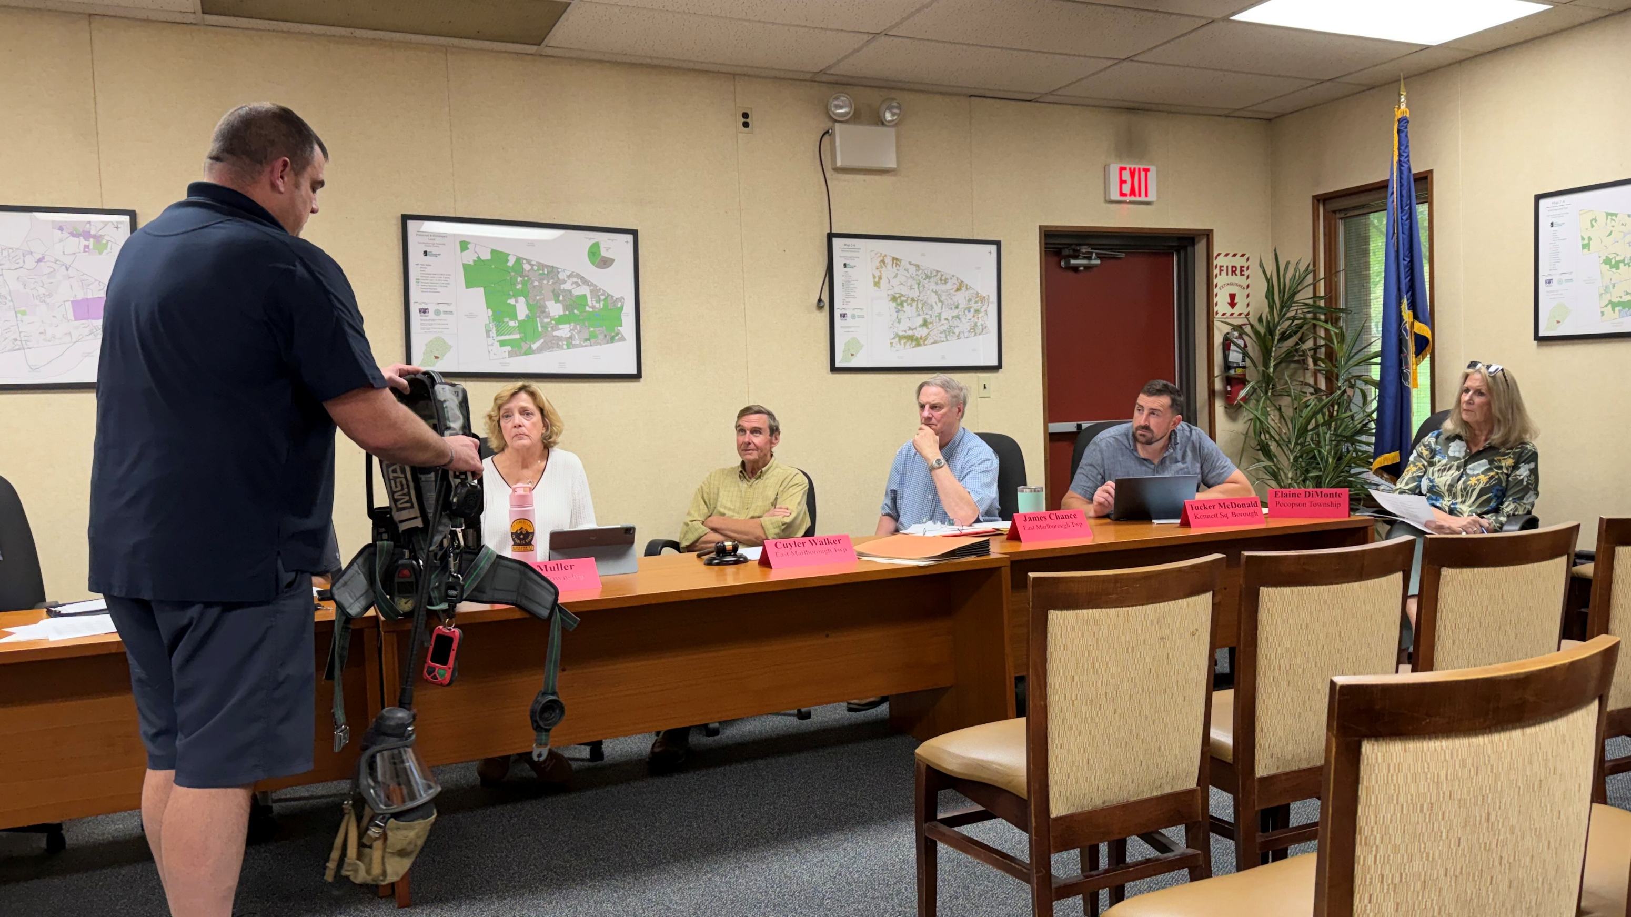
Capital Equipment 2027 – Air Packs
Expected $1,000,000 investment in 2027 to replace expiring air packs

Slide 23
Capital Forecasting
The original capital (fleet + equipment) plan presented in 2024 estimated that we would need an average of $1.8 to $2.2 million per year over the course of the plan.
The point was to ramp up to a consistent funding level by going from $750K to $1.25 million in 2025 followed by 4 years of $250K increases and then remaining flat.
In 2024 the original recommendation was as follows:
  2025: $1,250,000
  2026: $1,500,000
  2027: $1,750,000
  2028: $2,000,000
  2029: $2,250,000
  2030: $2,250,000
The above represents a 5 year average of $1,750,000 which is roughly the minimum average estimated by the 2024 plan.

Slide 24
Investment in Capital 2019-2026
Notes:
First started putting aside funding for capital vehicles/equipment in 2024.

Slide 25
Capital Investment Increase Over Time
Notes:
2024 was an increase of $750,000 in one year to build the capital fund. Since then, the increases each year have gone down.
2027 has not been determined.

Slide 26
Capital Investment Increase Over Time
Notes:
2024 was an increase of $750,000 in one year to build the capital fund. Since then, the increases each year have gone down.
2027 has not been determined.

Slide 27
Capital Forecasting & 2027
Capital Plan Forecasting Model
$75/$150/$150/$75
Adds $1mill in air packs which expire in 2027
Does not include equipment for 2028-2032
Concern is timing of Tractor Drawn Aerial payment in 2029 along with room for equipment
Expected Capital Balance Jan 1 2027 | $1,281,069.15
Ambulance remount fall 27 & air packs | ($1,259,741.00)
municipal contributions 2027 | $1,575,000.00
Balance Jan 1 2028 | $1,596,328.15
New pumper truck due late 2028 | ($1,490,708.00)
municipal contributions 2028 | $1,725,000.00
Balance Jan 1 2029 | $1,830,620.15
early 2029 Tractor drawn aerial | ($2,493,017.00)
Balance after paying for aerial | ($662,396.85)
municipal contributions 2029 | $1,875,000.00
Balance Jan 1 2030 | $1,212,603.15
2030 purchases | ($1,513,000.00)
municipal contributions 2030 | $1,950,000.00
2031 tower | ($2,800,000.00)
municipal contributions 2031 | $2,100,000.00
2032 engine | ($1,300,000.00)
municipal contributions 2032 | $2,250,000.00
Balance Jan 1 2033 | $1,899,603.15
In printouts as Option A
Notes:
2027 capital plan was adjusted based on addition of $1,000,000 in capital equipment/air packs.
They expire. Can’t flip one station and not flip them all. So replacing as a full department is safer for everyone because not interchangeable between different air packs. Every riding position is stored in vehicles, each station has compressor to fill these; these sit in the trucks; get dressed while moving. What that allows for is repairs, etc.

Slide 28
Capital Forecasting & 2027
Capital Plan Forecasting Model
$75/$125/$125/$75
Adds $1mill in air packs which expire in 2027
Does not include equipment for 2028-2032
Concern is timing of Tractor Drawn Aerial payment in 2029 along with room for equipment
Expected Capital Balance Jan 1 2027 | $1,281,069.15
Ambulance remount fall 27 & air packs | ($1,259,741.00)
municipal contributions 2027 | $1,575,000.00
Balance Jan 1 2028 | $1,596,328.15
New pumper truck due late 2028 | ($1,490,708.00)
municipal contributions 2028 | $1,700,000.00
Balance Jan 1 2029 | $1,805,620.15
early 2029 Tractor drawn aerial | ($2,493,017.00)
Balance after paying for aerial | ($687,396.85)
municipal contributions 2029 | $1,825,000.00
Balance Jan 1 2030 | $1,137,603.15
2030 purchases | ($1,513,000.00)
municipal contributions 2030 | $1,900,000.00
2031 tower | ($2,800,000.00)
municipal contributions 2031 | $2,025,000.00
2032 engine | ($1,300,000.00)
municipal contributions 2032 | $2,150,000.00
Balance Jan 1 2033 | $1,599,603.15
In printouts as Option B

Slide 29
Capital Forecasting & 2027
Capital Plan Forecasting Model
$50/$150/$150/$50
Adds $1mill in air packs which expire in 2027
Does not include equipment for 2028-2032
Concern is timing of Tractor Drawn Aerial payment in 2029 along with room for equipment
Expected Capital Balance Jan 1 2027 | $1,281,069.15
Ambulance remount fall 27 & air packs | ($1,259,741.00)
municipal contributions 2027 | $1,550,000.00
Balance Jan 1 2028 | $1,571,328.15
New pumper truck due late 2028 | ($1,490,708.00)
municipal contributions 2028 | $1,700,000.00
Balance Jan 1 2029 | $1,780,620.15
early 2029 Tractor drawn aerial | ($2,493,017.00)
Balance after paying for aerial | ($712,396.85)
municipal contributions 2029 | $1,850,000.00
Balance Jan 1 2030 | $1,137,603.15
2030 purchases | ($1,513,000.00)
municipal contributions 2030 | $1,900,000.00
2031 tower | ($2,800,000.00)
municipal contributions 2031 | $2,050,000.00
2032 engine | ($1,300,000.00)
municipal contributions 2032 | $2,200,000.00
Balance Jan 1 2033 | $1,674,603.15
In printouts as Option C

Slide 30
Capital Forecasting & 2027
Capital Plan Forecasting Model
$0/$200/$200/$0
Adds $1mill in air packs which expire in 2027
Does not include equipment for 2028-2032
Concern is timing of Tractor Drawn Aerial payment in 2029 along with room for equipment
Expected Capital Balance Jan 1 2027 | $1,281,069.15
Ambulance remount fall 27 & air packs | ($1,259,741.00)
municipal contributions 2027 | $1,500,000.00
Balance Jan 1 2028 | $1,521,328.15
New pumper truck due late 2028 | ($1,490,708.00)
municipal contributions 2028 | $1,700,000.00
Balance Jan 1 2029 | $1,730,620.15
early 2029 Tractor drawn aerial | ($2,493,017.00)
Balance after paying for aerial | ($762,396.85)
municipal contributions 2029 | $1,900,000.00
Balance Jan 1 2030 | $1,137,603.15
2030 purchases | ($1,513,000.00)
municipal contributions 2030 | $1,900,000.00
2031 tower | ($2,800,000.00)
municipal contributions 2031 | $2,100,000.00
2032 engine | ($1,300,000.00)
municipal contributions 2032 | $2,300,000.00
Balance Jan 1 2033 | $1,824,603.15
In printouts as Option D
Notes:
AJ: Fire department isn’t going away, municipal responsibility isn’t going away, need isn’t going away

Slide 31
Municipal Allocation Formula
Four categories, equally weighted
  Population
  Assessed value
  Fire Calls
  EMS Calls
For 2027 it’s based on 2025, the most recent complete year of data
Notes:
The Regional Department only covers 60% of Newlin Township so their population and assessed value are adjusted accordingly

Slide 32
Municipal Allocation Formula 2027 – FINAL
Approved at the September 8, 2026 KFERC Meeting
 | 2025 Population | 2025 Assessed Value | 2025 Fire/Rescue Responses | 2025 EMS Responses
East Marlborough Township | 7,924 | $791,352,180 | 333 | 762
Kennett Township | 9,253 | $854,530,240 | 382 | 996
Kennett Square Borough | 6,893 | $260,449,541 | 212 | 612
Pocopson Township | 4,480 | $350,442,280 | 122 | 478
Pennsbury Township | 3,879 | $399,012,810 | 159 | 411
Newlin Township (60% assessed value in calculation) | 816.6 | $80,207,682 | 44 | 60
TOTAL | 33,246 | 2,735,994,733 | 1,252 | 3,319
 | *Population Data: https://www.chescoplanning.org/resources/data-population.cfm
 | 2025 Population | 2025 Assessed Value | 2025 Fire/Rescue Responses | 2025 EMS Responses | 2027 Allocation Percentage | 2026 Allocation Percentage
East Marlborough Township | 23.8% | 28.9% | 26.6% | 23.0% | 25.579% | 26.38%
Kennett Township | 27.8% | 31.2% | 30.5% | 30.0% | 29.896% | 29.42%
Kennett Square Borough | 20.7% | 9.5% | 16.9% | 18.4% | 16.406% | 16.01%
Pocopson Township | 13.5% | 12.8% | 9.7% | 14.4% | 12.608% | 12.91%
Pennsbury Township | 11.7% | 14.6% | 12.7% | 12.4% | 12.834% | 12.80%
Newlin Township | 2.5% | 2.9% | 3.5% | 1.8% | 2.677% | 2.49%
 | 100.0% | 100.0% | 100.0% | 100.0% | 100.0% | 100.00%

Slide 33
Impact to Municipalities - $100K increase to capital
Impact with $100K increase to capital & $646K increase to operating | 2026 Allocation | 2027 Allocation | Amount Increase | Percentage Increase from FY26
East Marlborough Township | $1,608,450.23 | $1,750,367.99 | $141,917.76 | 8.823%
Kennett Township | $1,793,603.50 | $2,045,830.24 | $252,226.74 | 14.063%
Kennett Square Borough | $976,018.90 | $1,122,695.03 | $146,676.12 | 15.028%
Pocopson Township | $786,942.37 | $862,747.88 | $75,805.51 | 9.633%
Pennsbury Township | $780,467.70 | $878,214.53 | $97,746.83 | 12.524%
Newlin Township | $151,596.20 | $183,223.24 | $31,627.03 | 20.863%
KFERC TOTAL | $6,097,078.90 | $6,843,078.90 | $746,000.00 | 12.235%

Slide 34
Impact to Municipalities - $75K increase to capital
Impact with $75K increase to capital & $646K increase to operating | 2026 Allocation | 2027 Allocation | Amount Increase | Percentage Increase from FY26
East Marlborough Township | $1,608,450.23 | $1,743,973.32 | $135,523.09 | 8.426%
Kennett Township | $1,793,603.50 | $2,038,356.15 | $244,752.65 | 13.646%
Kennett Square Borough | $976,018.90 | $1,118,593.45 | $142,574.55 | 14.608%
Pocopson Township | $786,942.37 | $859,595.98 | $72,653.61 | 9.232%
Pennsbury Township | $780,467.70 | $875,006.12 | $94,538.43 | 12.113%
Newlin Township | $151,596.20 | $182,553.86 | $30,957.66 | 20.421%
KFERC TOTAL | $6,097,078.90 | $6,818,078.90 | $721,000.00 | 11.825%

Slide 35
Impact to Municipalities - $50K increase to capital
Impact with $50K increase to capital & $646K increase to operating | 2026 Allocation | 2027 Allocation | Amount Increase | Percentage Increase from FY26
East Marlborough Township | $1,608,450.23 | $1,737,578.66 | $129,128.43 | 8.028%
Kennett Township | $1,793,603.50 | $2,030,882.07 | $237,278.57 | 13.229%
Kennett Square Borough | $976,018.90 | $1,114,491.88 | $138,472.98 | 14.188%
Pocopson Township | $786,942.37 | $856,444.08 | $69,501.71 | 8.832%
Pennsbury Township | $780,467.70 | $871,797.72 | $91,330.02 | 11.702%
Newlin Township | $151,596.20 | $181,884.49 | $30,288.29 | 19.980%
KFERC TOTAL | $6,097,078.90 | $6,793,078.90 | $696,000.00 | 11.415%

Slide 36
Impact to Municipalities - $0 increase to capital
Impact with ZERO increase to capital & $646K increase to operating | 2026 Allocation | 2027 Allocation | Amount Increase | Percentage Increase from FY26
East Marlborough Township | $1,608,450.23 | $1,724,789.33 | $116,339.10 | 7.233%
Kennett Township | $1,793,603.50 | $2,015,933.90 | $222,330.40 | 12.396%
Kennett Square Borough | $976,018.90 | $1,106,288.74 | $130,269.84 | 13.347%
Pocopson Township | $786,942.37 | $850,140.28 | $63,197.92 | 8.031%
Pennsbury Township | $780,467.70 | $865,380.91 | $84,913.22 | 10.880%
Newlin Township | $151,596.20 | $180,545.74 | $28,949.54 | 19.096%
KFERC TOTAL | $6,097,078.90 | $6,743,078.90 | $646,000.00 | 10.595%

Slide 37
Notes:
This is the total of the contributions by the 6 KFERC Municipalities
Kennett Square Borough’s payments directly to LFC are included for comparison purposes

Slide 38
Notes:
This is the total of the contributions by the 6 KFERC Municipalities
Kennett Square Borough’s payments directly to LFC are included for comparison purposes
This show how the percentage increase is trending for the overall budget.
The 42% increase was primarily driven by the $750K investment in capital. KFERC went from $0 to $750,000

Slide 39
Municipal Allocation 2024-2027

Slide 40
Increase as a percentage 2024-207

Slide 41
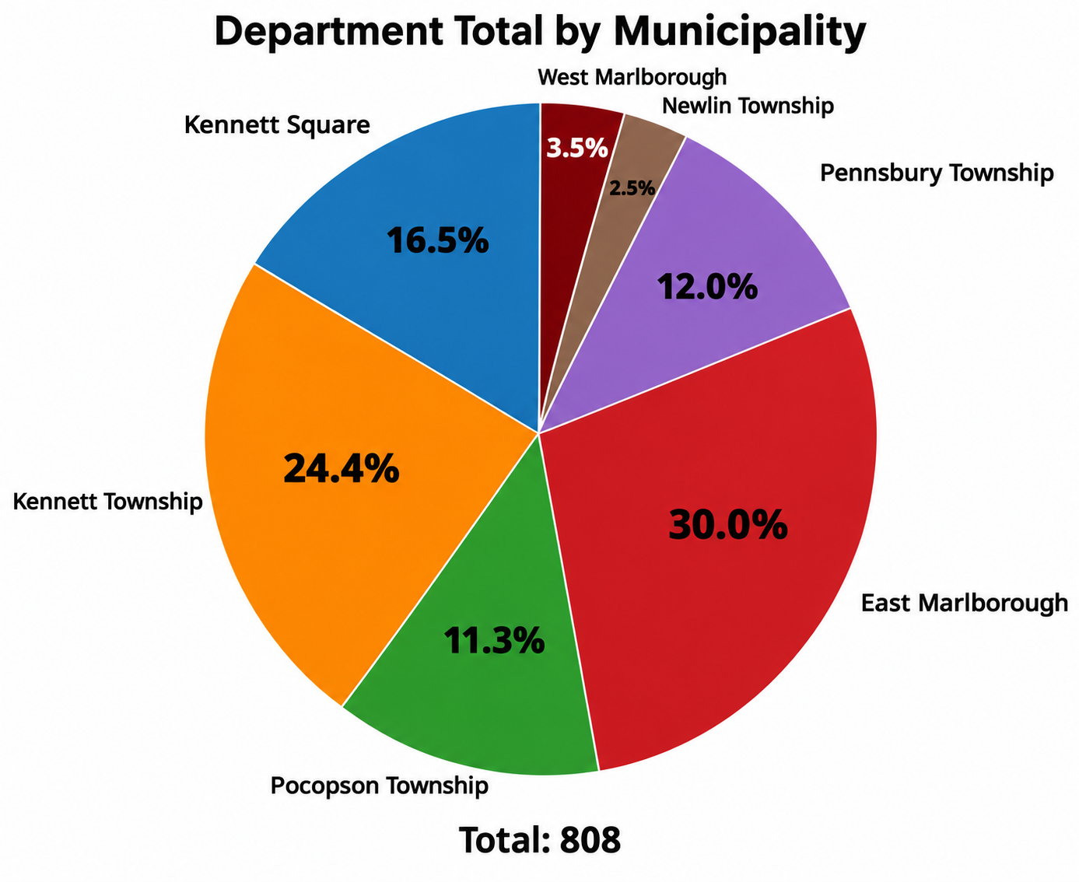
Regional Response Data
(as of 08/31/26)
2026 Fire Calls – In district

Slide 42
East Marlborough Township
EMS Calls – 461
Fire Calls – 242
Number of Active Volunteers – 5
Total 2026 Allocations – $1,608,450.23
(as of 08/31/26)

Slide 43
Kennett Township
EMS Calls – 585
Fire Calls – 197
Number of Active Volunteers – 3
Total 2026 Allocations – $1,793,603.50
(as of 08/31/26)

Slide 44
Kennett Square Borough
EMS Calls – 413
Fire Calls – 133
Number of Active Volunteers – 6
Total 2026 Allocations – $976,018.90
(as of 08/31/26)

Slide 45
Pennsbury Township
EMS Calls – 266
Fire Calls – 97
Number of Active Volunteers – 1
Total 2026 Allocations – $780,467.70
(as of 08/31/26)

Slide 46
Pocopson Township
EMS Calls – 302
Fire Calls – 91
Number of Active Volunteers – 1
Total 2026 Allocations – $786,942.37
(as of 08/31/26)

Slide 47
Newlin Township (KRFD Territory)
EMS Calls – 29
Fire Calls – 20
Number of Active Volunteers – 1
Total 2026 Allocations – $151,596.20
(as of 08/31/26)

Slide 48
DRAFT 2027 KFERC Budget
 | 2026 KFERC Budget |  | 2026 w/ Borough |  | 2027
Total Municipal Revenue | $5,121,060.00 |  | $6,097,078.90 |  | $6,793,078.90
Use of Fund Balance |  |  |  |  | $20,000.00
TOTAL REVENUE | $5,121,060.00 |  | $6,097,078.90 |  | $6,813,078.90
Transfer to Capital | -$1,259,880.00 |  | -$1,500,000.00 |  | -$1,550,000.00
 | ($1,500,000 minus Borough) |  | (includes Borough) |  | (50K Increase to Capital)
Expenses | 2026 |  | 2026 w/Borough |  | 2027
Funding for Fire Companies | $3,543,022.05 |  | $4,284,796.47 |  | $4,930,796.47
Volunteer Incentives | $250,000.00 |  |  |  | $250,000.00
Workers Compensation Reimbursement | $41,529.00 |  |  |  | $56,529.00
Audit | $7,200.00 |  |  |  | $7,200.00
D&O Insurance | $1,949.00 |  |  |  | $1,949.00
Form BCO-10 Filing | $15.00 |  |  |  | $15.00
Public Notices | $300.00 |  |  |  | $300.00
Administrator Pay | $14,000.00 |  |  |  | $14,000.00
Website | $1,000.00 |  |  |  | $1,000.00
TOTAL EXPENSES | $3,858,015.05 |  |  |  | $5,261,789.47
Revenue v Expense | $3,164.95 |  |  |  | $1,289.43

